Slide 1
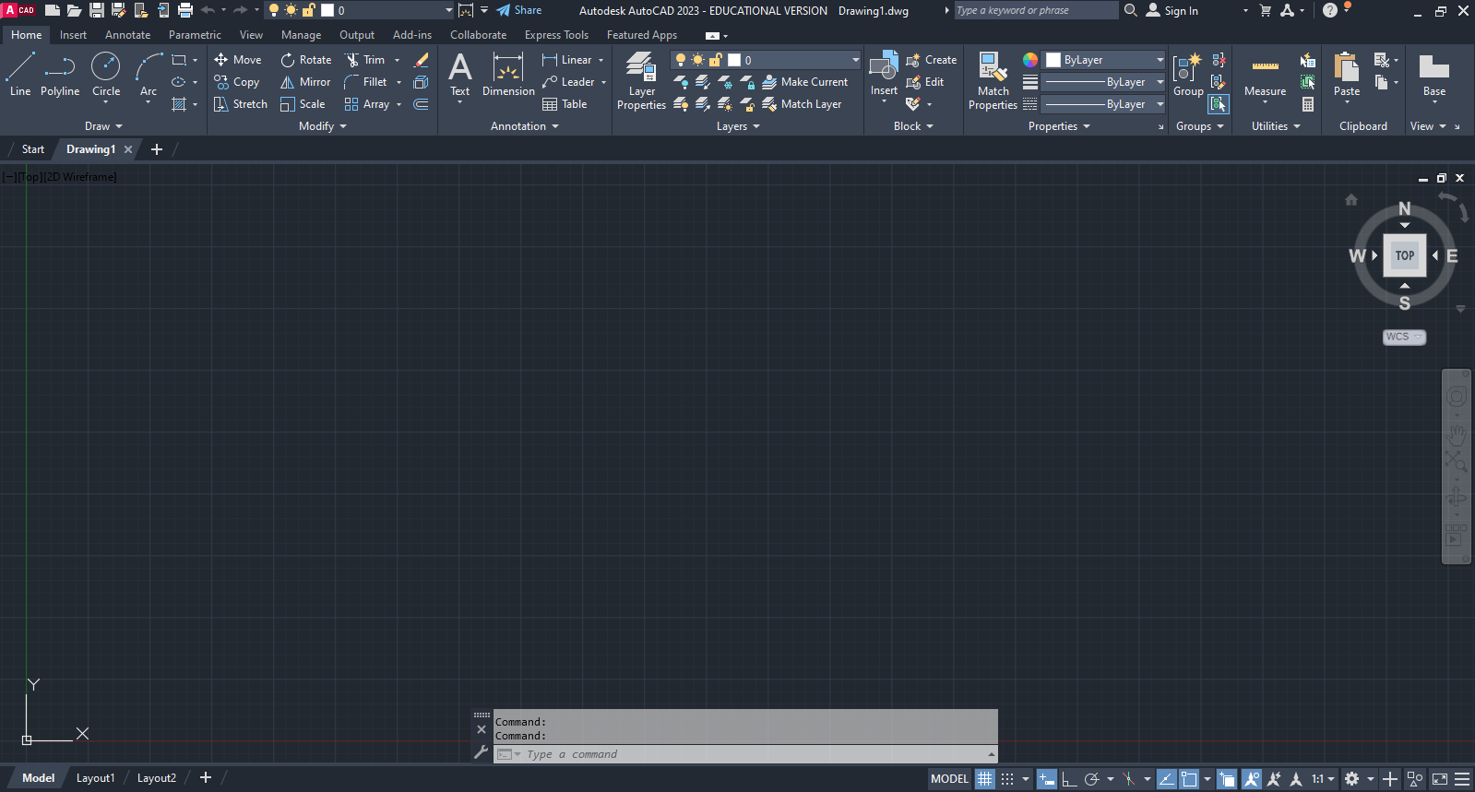
Unit 7 AutoCAD Layers
Notes:
This Powerpoint is a collection of links to video instruction for AutoCAD Layers feature. The videos are based off information from the textbook Up & Running with AutoCAD by Elliot Gindis and Robert Kaebisch, which is why there are references to sections or portions of information from the book. Pause the video periodically to practice the content that was covered.

Slide 2
Intro to Layers Part 1
https://mediaspace.minnstate.edu/media/CTE%20Layers%20Part%201/1_0zvqzh8j
Learning Outcomes:
Understand use of layers
Access Layer Property Manager
Create and delete layers
Make a layer current

Slide 3
Intro to Layers Part 2
https://mediaspace.minnstate.edu/media/CTE+Layers+Part+2/1_jl1570hu
Learning Outcomes:
Assign properties to a layer
Layer states

Slide 4
Applying Linetypes through Layers
https://mediaspace.minnstate.edu/media/CTE+Layers+Part+3/1_x43v0f2h
Learning Outcomes:
Load linetypes
Adjust linetype scale

Slide 5
Layers and the Ribbon
https://mediaspace.minnstate.edu/media/CTE+Layers+Part+4/1_cw7w0cs4
Learning Outcomes:
Match properties
Adjust layers and layer states from Ribbon

Slide 6
References
All videos are based off content from the text
  Up & Running with AutoCAD 2022,
    2D and 3D Drawing, Design and Modeling
    by Elliott Gindis and Robert Kaebisch
    Elsevier Inc
    Academic Press
    ISBN: 978-0-323-89923-9

